Slide 1
Evaluating Classification Models
Objective: Measure performance using Accuracy & Confusion Matrix
Understand why Accuracy can mislead

Slide 2
Task 1: Accuracy
Task 1:
Calculating Accuracy
Accuracy is the simplest classification metric, defined as the ratio of correct predictions to the total number of predictions.
Scenario: You have trained a Logistic Regression model to predict student placement (1 for Placed, 0 for Not Placed). For a test set of 10 students, your results are as follows:
Actual Labels: [1, 0, 1, 1, 0, 1, 0, 1, 1, 0]
Predicted Labels: [1, 1, 1, 1, 0, 0, 0, 1, 1, 0]
Instructions:
Identify the number of correct predictions (where Actual == Predicted).
Calculate the Accuracy score using the formula:
Accuracy = Correct Predictions\Total Predictions
Explain the result as a percentage.
Formula: Accuracy = Correct / Total
Actual: [1,0,1,1,0,1,0,1,1,0]
Predicted: [1,1,1,1,0,0,0,1,1,0]

Slide 3
Accuracy Result
Task 2: Building a Confusion Matrix
While Accuracy gives a single number, a Confusion Matrix helps you understand the nature of the errors your model is making.
Instructions:
Using the data from Task 1, create a 2 x 2 Confusion Matrix. Map the following four values:
True Positive (TP): Model predicted 1, and it was actually 1.
True Negative (TN): Model predicted 0, and it was actually 0.
False Positive (Type 1 Error):
Model predicted 1, but it was actually 0.
False Negative (Type 2 Error): Model predicted 0, but it was actually 1.
Label the matrix with "Actual" on the rows and "Predicted" on the columns.
Correct Predictions = 7
Total = 10
Accuracy = 70%

Slide 4
Confusion Matrix
TP: predicted 1, actual 1
TN: predicted 0, actual 0
FP: predicted 1, actual 0
FN: predicted 0, actual 1

Slide 5
Matrix Values
TP=5, TN=2, FP=1, FN=2

Slide 6
Type 1 & Type 2 Errors
Task 3: Analyzing Type 1 and Type 2 Errors
Errors are not always equal in their impact.
Questions:
Define Type 1 Error (False Positive) and Type 2 Error (False Negative) based on the student placement scenario.
Health Science Application: If a model is predicting heart disease, which error is more dangerous: telling a sick patient they are healthy (False Negative) or telling a healthy patient they are sick (False Positive)? Explain why.
Type 1: False Positive
Type 2: False Negative

Slide 7
Health Example
False Negative more dangerous
Sick patient labeled healthy

Slide 8
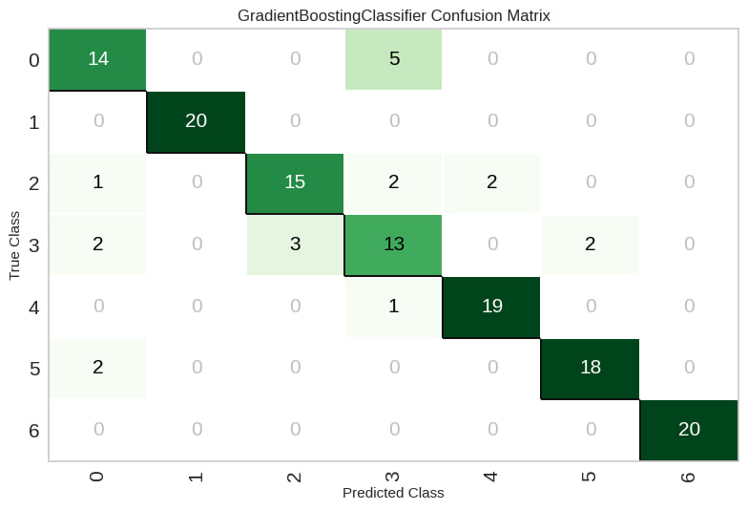
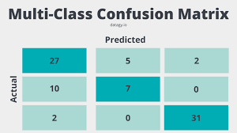
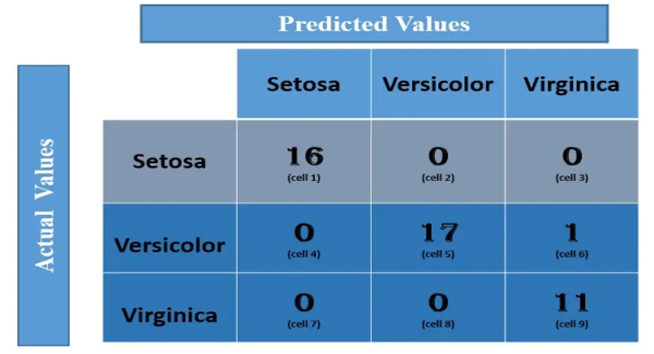

Slide 9
Imbalanced Dataset
Task 4: The Problem of Imbalanced Datasets
Accuracy can be misleading when one class significantly outweighs the other.
Scenario: You are building a model to detect terrorists at an airport. Out of 100,000 passengers, only 1 is a terrorist.
If your model simply predicts "Not a Terrorist" for everyone, what would its Accuracy be?
Why is this high Accuracy score considered "bad" or misleading in this specific context?
100,000 passengers, 1 terrorist
Predict all 'Not Terrorist'
Accuracy ≈ 99.999%

Slide 10
Why Misleading
Fails on rare class
Needs Precision, Recall

Slide 11
Conclusion
Use multiple metrics
Accuracy alone is insufficient

